Slide 1


Applied AI / AI Services Offerings

Slide 2

“Know How” and
“Done That” AI Experts
UK
Poland
United States
Germany
Seasoned GenAI experts with deep experience helping data science and business teams harness AI to transform everyday workflows. With a track record across industries, we bring the clarity, confidence, and capability to make GenAI work for your business.
Mexico
India
Philippines
12
40+
400+
4
Brazil
Countries
Locations
Enterprise Clients
AI Studios
Hyderabad, IND
Austin, US
Manila, PH
11000+
300
3000
~2000
Chennai, IND
Global Engineering Hubs
AI Studios
Ascenders
Agent Developers
GenAI Developers
Agentic Tasks built
FOCUS AREAS
Modern AI
Operationalization
Contact Center Transformation
Intelligent Document Processing
Banking &
Financial Services
Healthcare &
Lifesciences
Communications,
Media &
Entertainment
Business ^{AI}
GenAI Validation and Hardening
Knowledge / Information Management
Business Process Agent-i-fication
High Tech &
Product Engineering
Retail, Consumer Travel &
Hospitality
Energy & Utilities
CAPABILITIES
AI TALENT TRANSFORMATION
INDUSTRIES
Copyright © 2025 Ascendion. All rights reserved

Slide 3



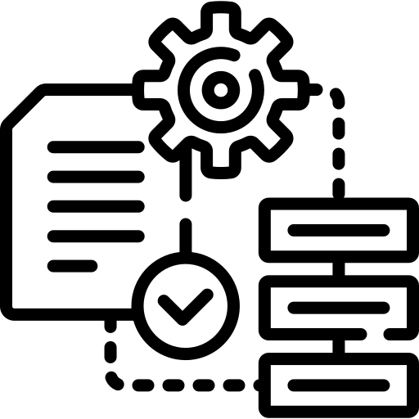





Our Offerings : Applied AI / AI Services
AI Advisory
Rapid Prototyping
1. Tell me what to do
Contact Center Modernization
Agentic Document Processing
Business Process Agentification
2. Help me do it
Information and Knowledge Management
AI Validation and Hardening
Agentic Platform Buildout
Modern AI Operationalization
3. Operationalize it for me
Notes:
Confluence KK keynote tables v0.1.xlsx

Slide 4




AI Advisory
The Situation:
as Generative and Agentic AI capabilities advance at unprecedented speed, enterprise leaders are grappling with how to harness this potential in a purposeful and responsible way. While early Gen AI pilots have demonstrated productivity gains, organizations are also seeking to benefit from autonomous, task-oriented agents that can drive greater automation, decision support, and workflow orchestration
Top Challenges
No unified strategy for Gen + Agentic AI across the enterprise
Isolated pilots with limited business integration
Governance gaps around safety, compliance, and accountability
Legacy systems & siloed data block intelligent automation
Low readiness for agent-assisted and autonomous workflows
Business Outcomes & Metrics
15–25% acceleration in time-to-value 2–4x increase in ROI on AI investments 3–5x increase in AI adoption
Gen AI & Agentic AI Strategy & Visioning
Defines how Generative and Agentic AI can drive business value, align with enterprise goals, and support long-term growth.
Technical Readiness & Architecture Advisory Assesses current technology capabilities and develops a secure, scalable architecture to support AI integration across the enterprise.
Operating Model & Governance Design
Establishes the structure, roles, and policies needed to manage AI initiatives safely, effectively, and at scale.
Data, Model & Ecosystem Readiness
Ensures the organization has the right data, models, and external partnerships in place to build and run effective AI solutions.
Use Case Prioritization & Value Roadmapping
Identifies and ranks AI opportunities based on impact and feasibility, creating a clear roadmap for phased implementation.
Organizational Change & Capability Building
Equips teams with the skills, structures, and support needed to adopt AI successfully and operate in an AI-enabled environment.
30-50%
Reduction in duplicated AI experimentation
25-40%
Reduction in operational risk exposure
30-40%
Accelerated time-to-deployment
100%
Auditability of AI decisions and outputs
50-70%
Reduced resistance to change
Key Improvements
Your AI Enablement Partner: Combining advisory expertise and engineering excellence to operationalize Gen AI and Agentic AI at scale.

Slide 5
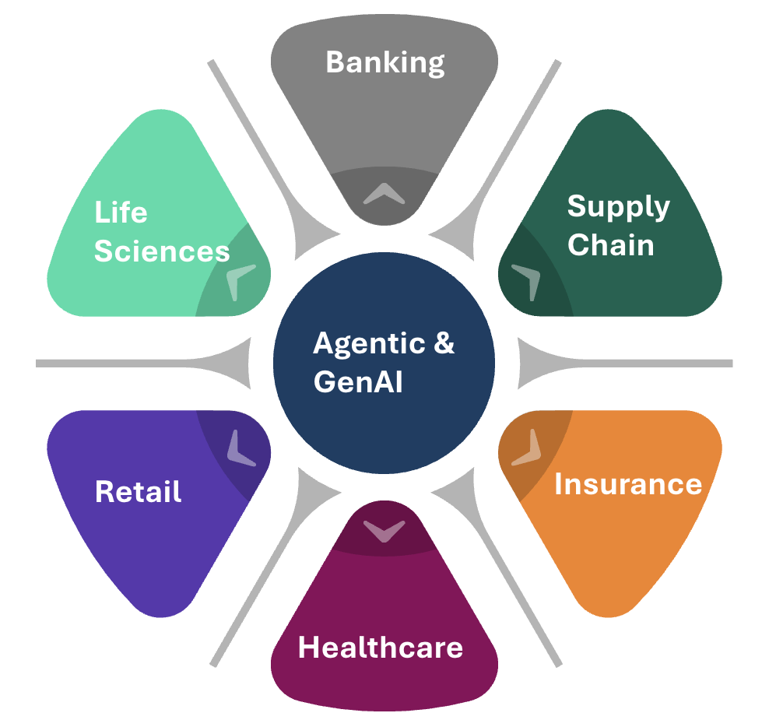
Rapid Prototyping for Agentic AI: enabling the Art of the Possible
The Situation: GenAI experimentation is often delayed by long dev cycles, unclear value, and high engineering effort.
Rapid prototyping enables us to explore the art of the possible, test feasibility quickly, and prioritize what delivers maximum value.
Helps teams shift from “Can we build this?” to “Should we build this?”
Helps enterprises focus only on what works, and feed validated ideas into scalable delivery. Reduces cost, improves learning velocity, and derisks investments
Use prebuilt agents, tools, and RAG modules
Low-code interfaces , Synthetic Data
Connect lightweight data and APIs
Standalone agent execution with MCP-lite setups
Iterative and Proven Approach
Ideation to PoC
Start Fast with Agentic & GenAI
Turns ambiguous ideas into tangible working prototypes
Run user testing with SMEs and business users
Version prompts, modify toolchains instantly
Continuously refine agents and RAG responses
Focus Resources on What Works
Test and Iterate
PoC outcomes directly plug into scale-up workflow
Evaluate and Gate
Evaluate and Apply Go / No-Go decision criteria
Feed successful PoCs into the blueprint track
Key Highlights
2 weeks
Max time to PoC
200+
80-90% faster
Using Agentic
and GenAI
PoC built

Slide 6















Transforming your Contact Centre with Agentic AI
The Situation: Enhance, Don't Replace
Traditional contact centres face significant challenges, including high agent attrition (>30%) and rising operational costs.
The objective is to preserve existing infrastructure by adding an intelligent AI layer to address these issues and drive superior outcomes.
Core AI Capabilities
Flexible and Tested Approach
More..
Intelligent Virtual Agents
Resolve complex issues end-to-end.
Extending Hyper-scalers
User Memory
Developing Custom AI
Actions
CRM
Real-Time Agent Assist
Guide agents with smart suggestions.
AI Agent
Knowledge Query
Integrating 3rd-Party Tools
Transactional Query
Actionable Insights
Analyze 100% of conversations.
Backed by comprehensive AI testing (functional, UX, adversarial) to ensure a robust system.
others
Cognitive Reasoning
Foundational Knowledge
Base Skills
Enterprise Backend
Agent Assist
Your Knowledge
Proven Business Outcomes
15%
A Leading Retailer
99.8%
A Global Health Provider
+BYO RAG
Increase in CSAT
In Compliance Adherence

Slide 7
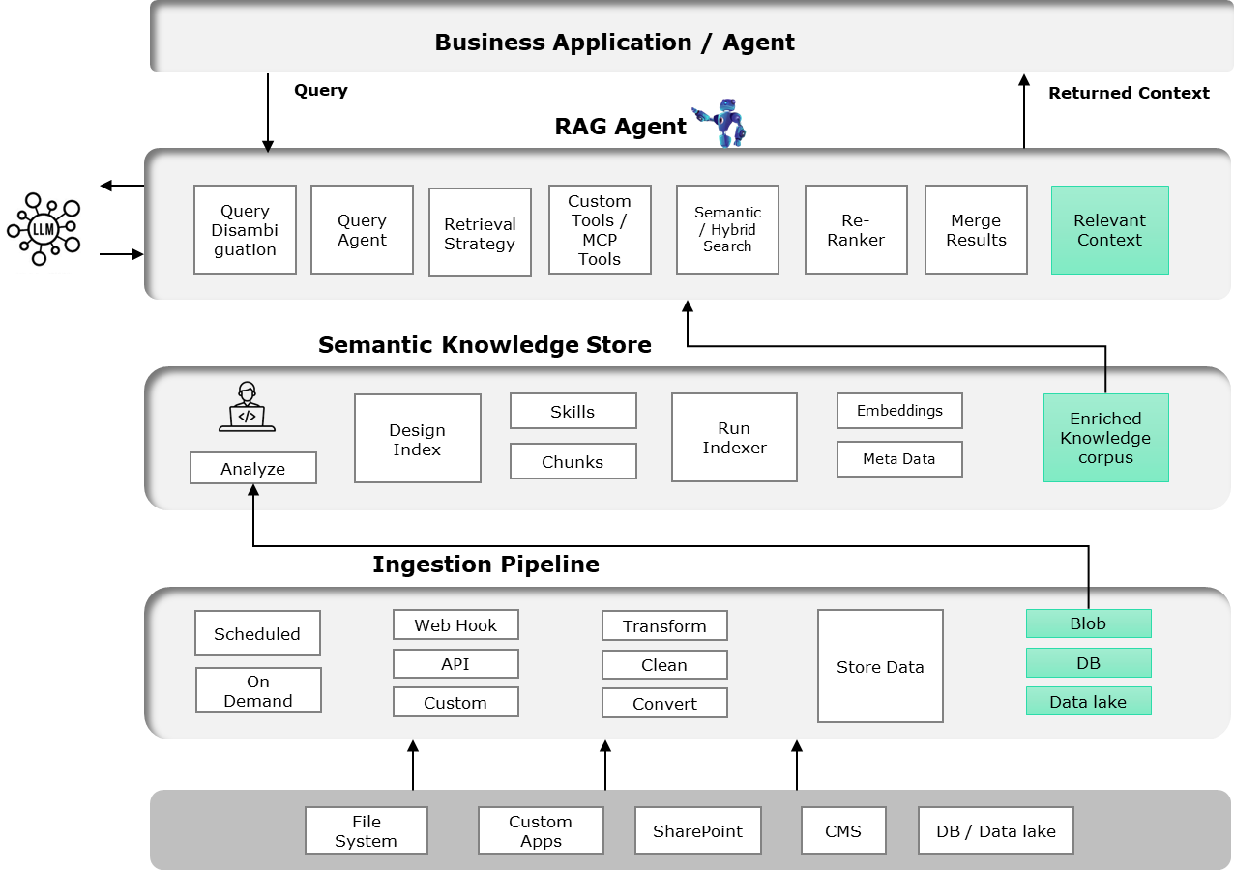



Information and Knowledge Management
The Situation: Connect the dots amongst documents that “are all over the place” …. literarily
Your organization’s knowledge are hidden amongst many documents, web sites, wikis, and repos
Your colleagues are wasting time searching them and finding answers … with varying level of success
Let the AI connect the dots for them
Core AI Capabilities
Flexible and Tested Approach
Intelligent Retrieval
Retrieve relevant context using semantic/ hybrid search with query re-write, retrieval planning and re-ranking
Ingestion from multiple sources
Built-in chunking, embedding and re-ranking knowledge
Semantic Knowledge Store
Chunk, embed, and enrich content with metadata, skills, and lineage to create a searchable enterprise corpus.
Semantic search with metadata filtering
Feedback loops improve chunking, re-ranking and metadata quality
Scalable Ingestion Pipeline
Ingest data from diverse enterprise systems via scheduled, API, or custom pipelines..
Proven Business Outcomes
20+
Enterprises benefitted
and counting..

Slide 8
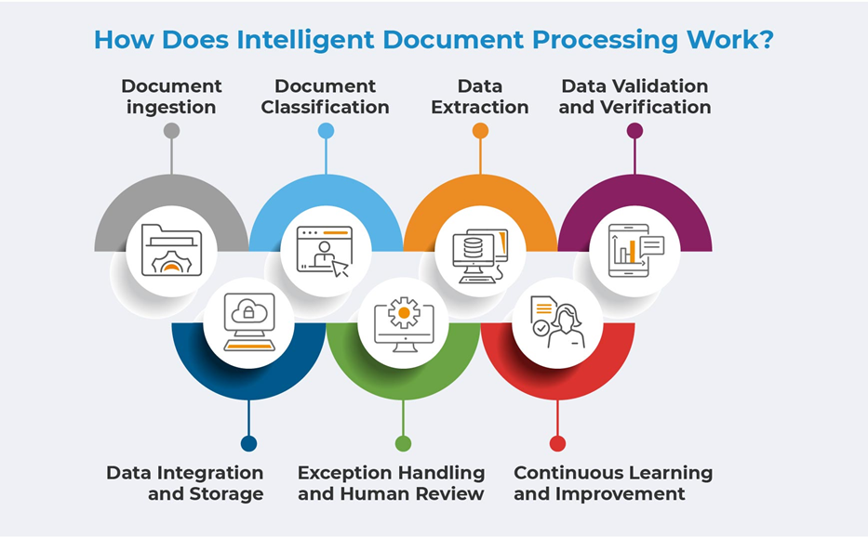


Agentic Document Processing
The Situation: Agent-i-fy processing of your documents …. Regardless of their form and format
Enterprises deal with a high volume of unstructured and semi-structured documents (invoices, forms, contracts, medical records, etc.) which are manually processed—leading to delays, errors, and compliance risks.
Intelligent Document Processing (IDP) using Agentic AI enables automation by extracting, classifying, and validating information from documents with high accuracy, auditability, and integration capabilities.
Core AI Capabilities
Flexible and Tested Approach
Functional Validation
Ensured model accuracy, relevance, and consistency across prompt-response pairs.
Ingest documents via email, API, SharePoint or RPA or file systems
Apply layout-aware parsing, OCR, NER, and table extraction
Domain-Enriched Ontologies
Enhance extracted data with domain-specific taxonomies, entity normalization, and policy-rule engine.
Use pre-trained & fine-tuned models with contextual validation
Feedback loops improve field accuracy
Automated Workflows & Feedback Loops
Trigger downstream actions with human-in-the-loop validation and continuous improvement
Proven Business Outcomes
90%
A Leading Bank
70%
A Leading Health Care Provider
Your End-to-End Partner
Accuracy
Efficiency Gains

Slide 9
AI/GenAI Validation and hardening
The Situation: GenAI systems can hallucinate … and generate some ‘off the mark’ responses
A comprehensive GenAI model validation framework designed and deployed across 20 enterprise clients spanning healthcare, finance, legal, and IT supportdomains.
Prevention against advererial attacks – Codify and scale AI policies and compliance
Functional Validation
Ensured model accuracy, relevance, and consistency across prompt-response pairs.
Business Outcomes & Metrics
Highlights
~12,000
1,500+
Conversation flow testing
Test cases executed
Defects Logged and Analysed
Hallucination Assessment and Prevention
Built automated pipelines to detect factual inconsistencies, unsupported claims, and unreliable generations
Prompt variation and edge-case validation
Defect Analysis
Guardrail and safety feature assessment
~40%
~35%
~25%
Adversarial Threat Assessment and Mitigation
Injected edge-case and prompt-perturbation scenarios to evaluate model robustness and resilience.
Automated scoring using LLMs and evaluation tools
Hallucinations
Functional
Adversarial
~40%
~35%
~25%
Key Improvements
Hallucinations
Functional
Adversarial

Slide 10





Let your people do the High-value work
The Situation: Don’t waste your people’s time, doing the mechanical and repetitive tasks
AI is good at doing the repetitive tasks – let the AI do it for your people
Free your people to spend all their time on core, higher value work
1
Process Inventory and Decomp
3
Agentic Flow Implementation
5
Deployment and Scaling
Process Discovery and Mapping
Task Decomposition
Agentification Assessment
ROI and Feasibility Analysis
Agent Development
System Integration
User Interface Design
Testing and Validation
Phased Rollout
Performance Monitoring
Continuous Improvement
Enterprise Scaling
2
Human Agent Collab Design
4
Organizational Transformation
Agent Role Definition
Human in the loop architecture
Process redesign
Governance Framework
Change Management
Training and Skill development
Organizational Restructuring
Knowledge base and Support System

Slide 11
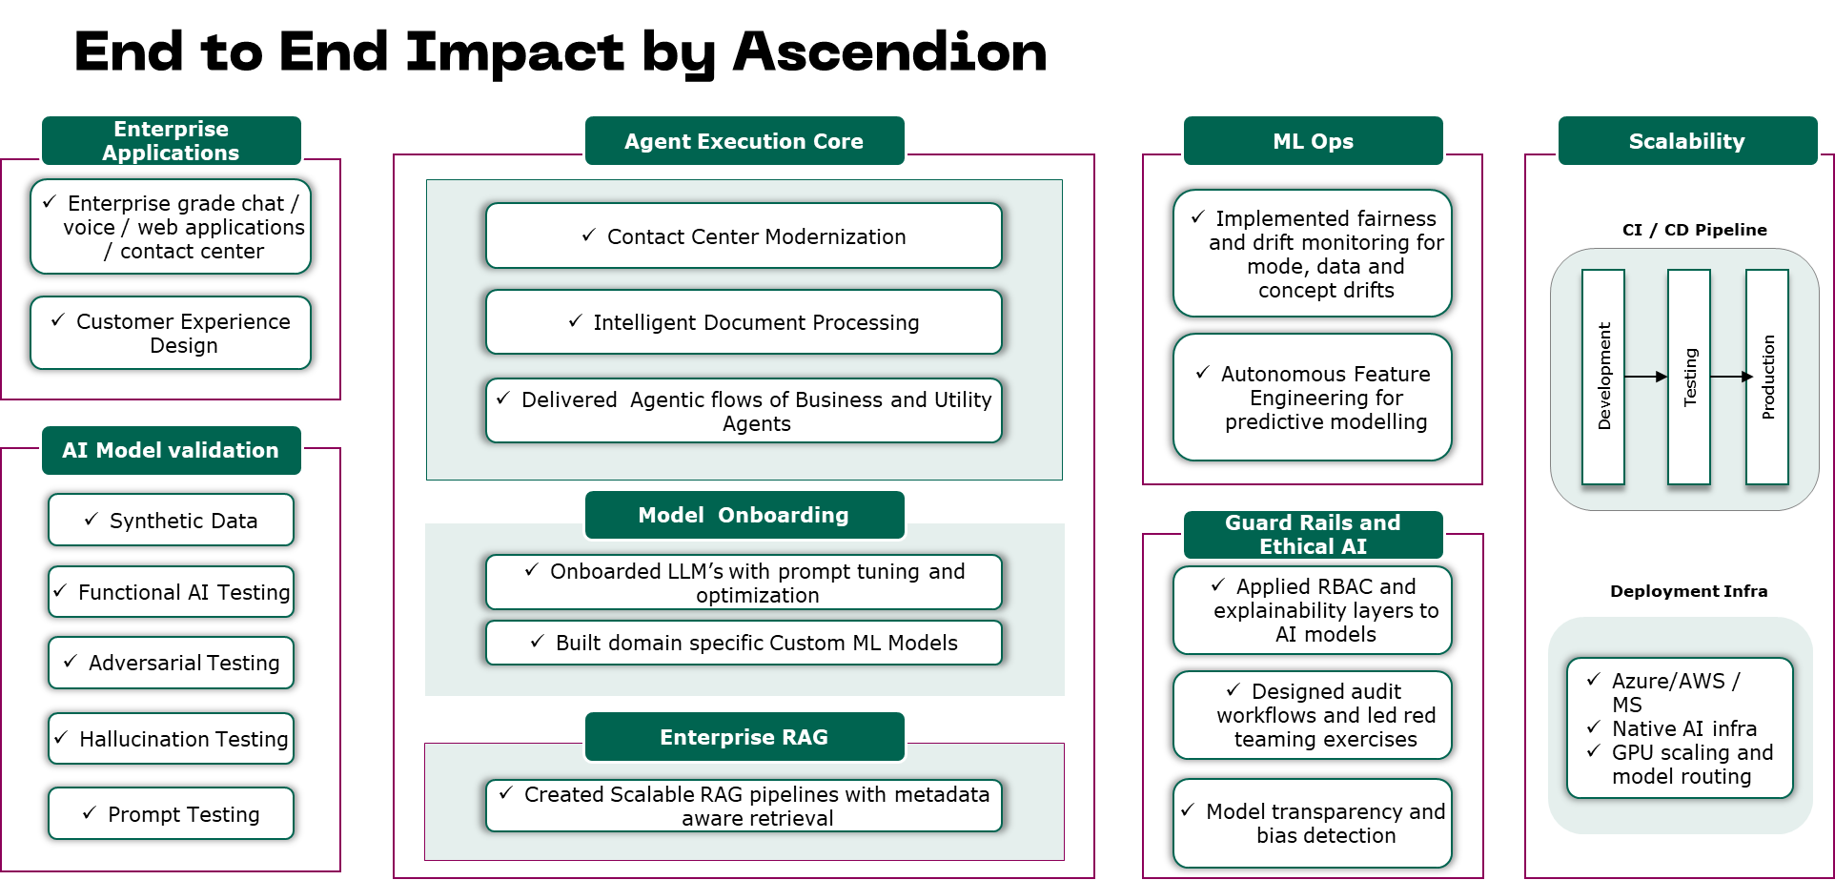
Agentic Platform Buildout
The Situation: Enterprises need a reference framework to scale intelligent agents safely and efficiently.
Fragmented AI Experiments → Disconnected PoCs with no path to scale.
Lack of Governance → Shadow AI, hallucinations, policy violations.
Low Reuse → Agents built per use case with no modularity
Core AI Capabilities
Highlights
Foundational Setup
Tech Stack / Orchestration /
Telemetry/ Guardrails
Ensure safe, governed AI interactions
Enable proactive, intelligent automation at scale
Pilot Use Cases
2-3 Business Scenarios
Deploy and Evaluate
Reduce time-to-value for AI investments
Drive innovation with reusable, composable agents
Scale and Extend
Enable agent federation across departments
Harden security, compliance, and governance models
Framework Blueprint Implementation
Understand Business Use Cases, IT and Cloud Landscape
Decide on the Tech Stack
Identify 1-2 Reference Use Cases
Define framework, Standards, Scalability and Security
Side by side start developing the reference use case
Refine and Release the Framework and Ref Implementation
Your End-to-End Partner

Slide 12
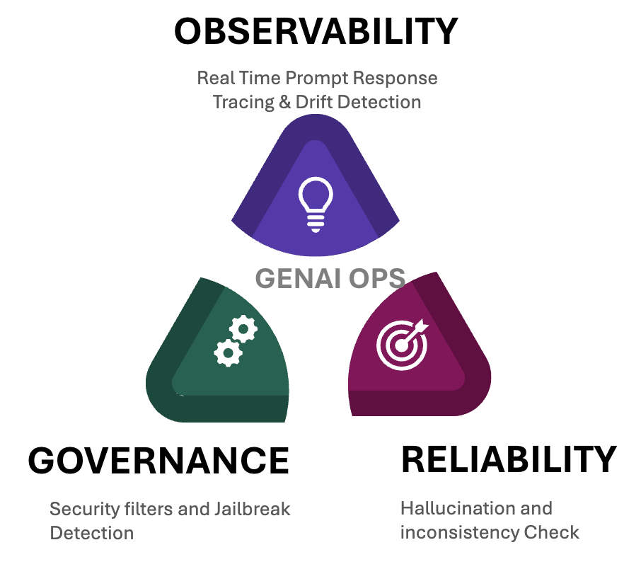
Modern AI Operationalizing: Observability, Reliability & Governance
The Situation: GenAI systems require continuous validation and oversight post-deployment
Unlike traditional ML, GenAI systems are prompt-driven, context-sensitive, and non-deterministic — making them harder to monitor and govern.
Requires robust observability, testing, and guardrails to maintain performance, reliability, and safety at scale.
We continuously monitor GenAI applications in production to ensure safe, reliable, and governed behavior — even as prompts, data, and user interactions evolve
Core AI Capabilities
Flexible and Tested Approach
Observability
Real-time logging and tracing of prompts, context, and tool usage
Dashboards for latency, token usage, and anomaly detection
Ingest documents via email, API, SharePoint or RPA or file systems
Reliability
Prompt regression testing and output consistency scoring
Automated hallucination detection pipelines
Load, failover, and throughput testing for LLM services
Apply layout-aware parsing, OCR, NER, and table extraction
Use pre-trained & fine-tuned models with contextual validation
Feedback loops improve field accuracy
Governance
Guardrail validation for jailbreaks, toxicity, and injection attacks
Prompt versioning and rollback frameworks
Human-in-the-loop review pipelines and feedback integration
Key Improvements
30-45%
~60%
Hallucination Reduction
Your End-to-End Partner
Prompt Consistency Improvement
>75%
Prompt Automation Coverage

